Slide 1
PIC16fF877A BASED ELEVATOR MODEL
- Priyanka Borgaonkar | StellarRimz

Slide 2
INTRODUCTION
An elevator or lift is a type of vertical transportation that moves people or goods between floors (levels, decks) of a building, vessel, or other structure.
PIC (usually pronounced as "pick") is a family of microcontrollers made by Microchip Technology, derived from the PIC1650[1][2][3] originally developed by General Instrument's Microelectronics Division. The name PIC initially referred to Peripheral Interface Controller.[4][5] The first parts of the family were available in 1976; by 2013 the company had shipped more than twelve billion individual parts, used in a wide variety of embedded systems.

Slide 3
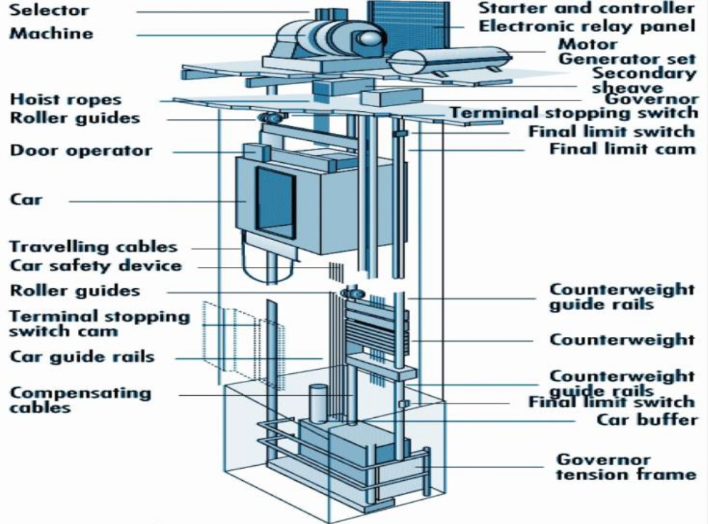
BASIC MODEL

Slide 4
COMPONENTS
Pic Microcontroller.
PICKIT3.
DC Motor,Motor Driver IC.
LCD Display.
Voltage Regulator IC.
4 MHz Crystal Oscillator.
Resistors,Capacitors,Diodes,Transistors,LEDs.
Rectifier IC.
Bread Board.
Connectors,Jumpers,wires.
Power supply.
An elevator prototype.

Slide 5
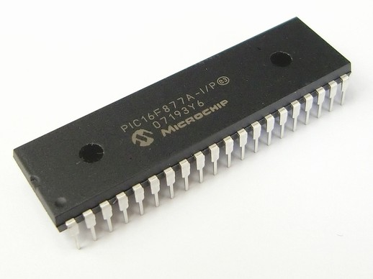
PIC CONTROLLER
This is a fundamental part of the CPU card used in an elevator.
PIC devices are popular with both industrial developers and hobbyists due to their low cost, wide availability, large user base, extensive collection of application notes, availability of low cost or free development tools, serial programming, and re-programmable Flash-memory capability.
PIC16F877A controller IC

Slide 6
PIC16F877A FEATURES
Parameter Name | Value
Program Memory Type | Flash
Program Memory (KB) | 14
CPU Speed (MIPS) | 5
RAM Bytes | 368
Data EEPROM (bytes) | 256
Digital Communication Peripherals | 1-UART, 1-A/E/USART, 1-SPI, 1-I2C1-MSSP(SPI/I2C)
Capture/Compare/PWM Peripherals | 2 CCP
Timers | 2 x 8-bit, 1 x 16-bit
ADC | 8 ch, 10-bit
Temperature Range (C) | -40 to 85
Operating Voltage Range (V) | 2 to 5.5
Pin Count | 40

Slide 7
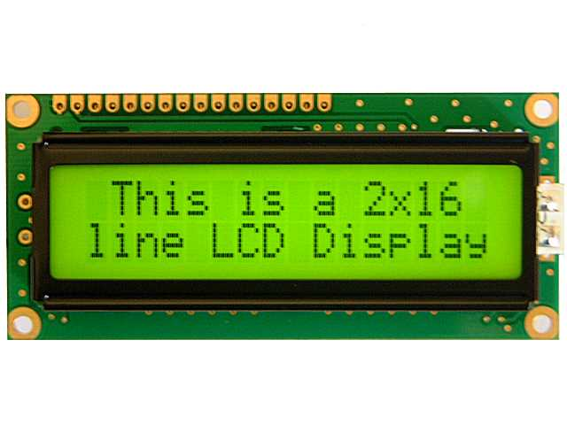
LCD DISPLAY
2*16 Liquid Crystal Display
Used as an indicator for elevator position and movement.
The JHD 162A lcd is fully compatible with the HD44780 LCD.
.Hence the same set of the codes will work for both.It is a 16*2 Lcd module i.e. it has 16 columns and two rows for display.
It can operate in either 8 bitmode or 4 Bit mode.
In 8bit mode , an 8 bit data is sent to the LCD from the MCU. Whereas in 4 bit mode, 4 bits of data are sufficient to operate it.

Slide 8
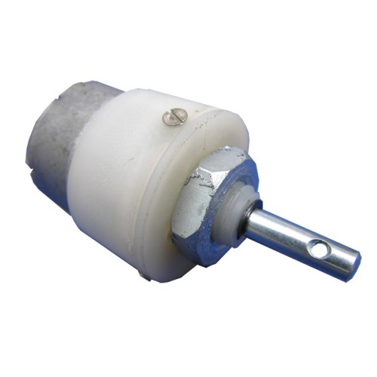
DC MOTOR
A 100 RPM geared 12V DC motor is used.
The DC motor connected to a pully control the
up-down movement of elevator.
The Clockwise rotation corresponds to upward
movement while the anticlockwise rotation corresponds to
downward movement.

Slide 9
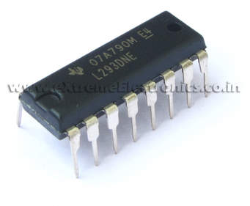
MOTOR DRIVER IC
L293D
The Device is a monolithic integrated high voltage, high current four channel driver designed to accept standard DTL or TTL logic levels and drive inductive loads (such as relays solenoides, DC and stepping motors) and switching power transistors.
To simplify use as two bridges each pair of channels is equipped with an enable input. A separate supply input is provided for the logic, allowing operation at a lower voltage and internal clamp diodes are included. This device is suitable for use in switching applications at frequenciesup to 5 kHz.

Slide 10
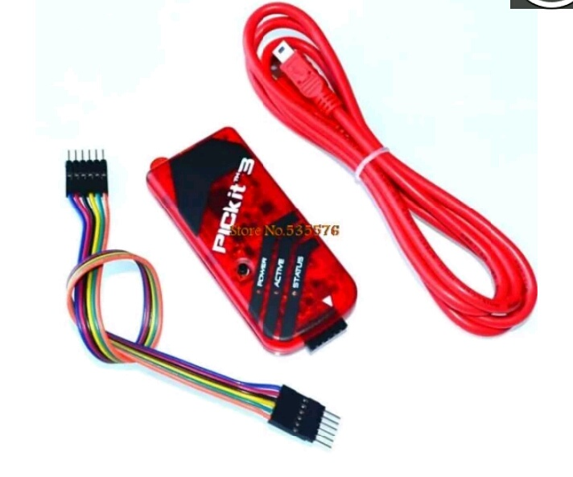
PICKIT3
This the new PICKIT3 from microchip.The PICKIT3 allows debugging and programming of PIC.and dsPIC.Microcontrollers using the powerful graphical user interface of the MPLAB integrated development environment.
FEATURES:
Real execution.
MPLAB IDE compatible
Built in short-circuit monitor.
Firmware upgradable from PC web download.
Fully enclosed.
Read/write program and data memory of microcontroller
Erase of program memory space with execution.

Slide 11
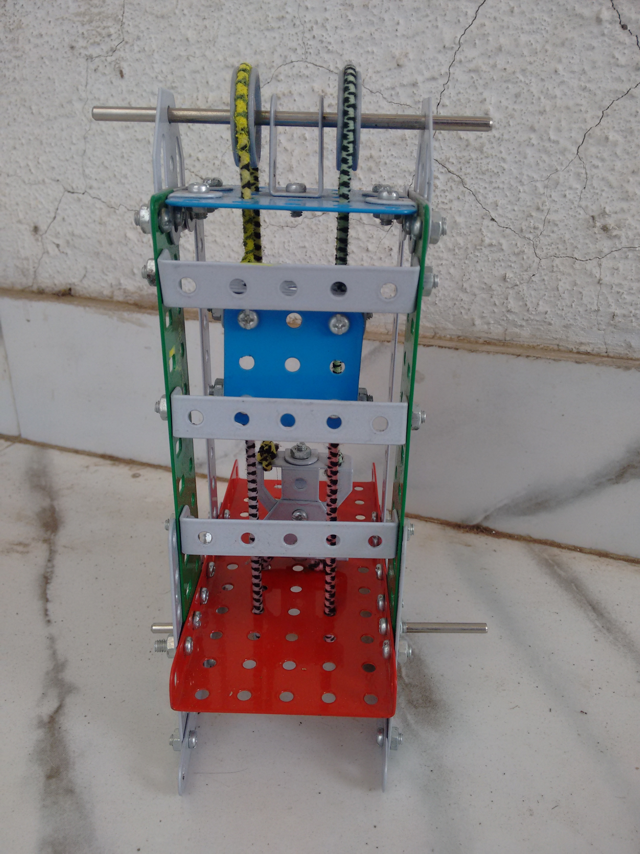
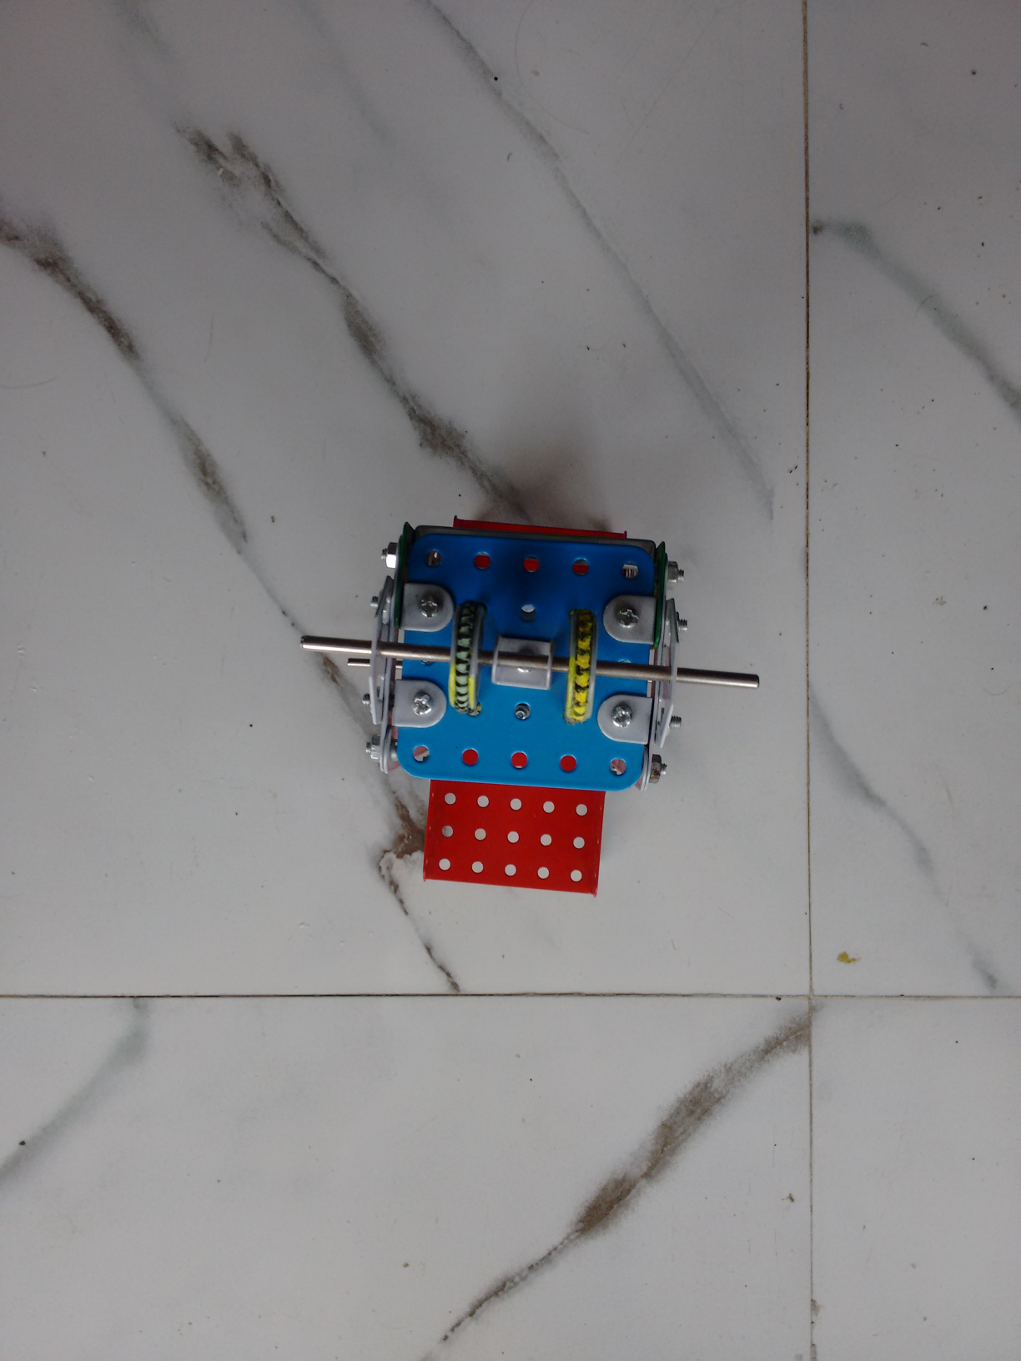
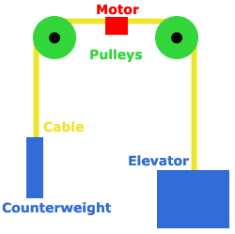
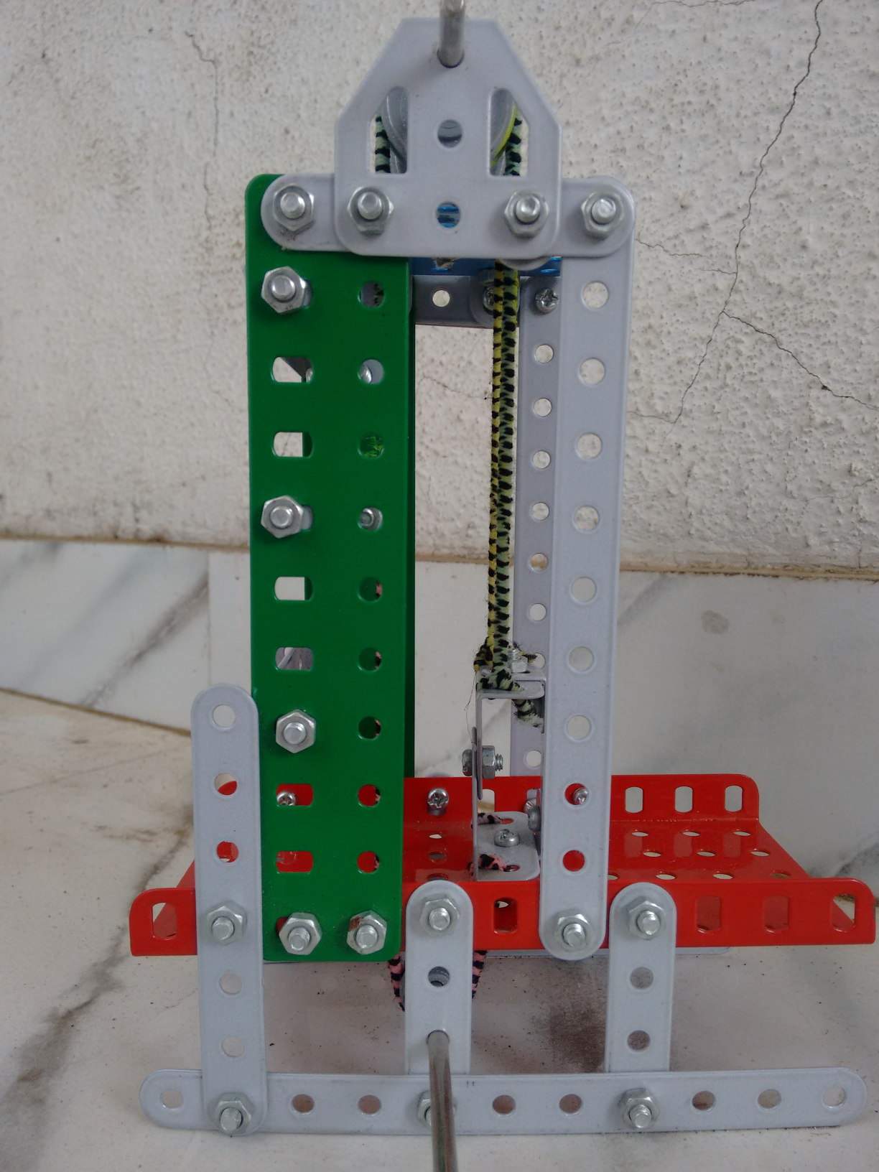
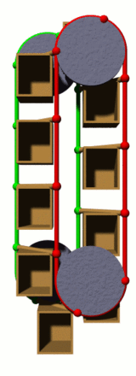
ELEVATOR PROTOTYPE
Front view
Top View
Basic Principle
Side view
up-down motion

Slide 12
ELEVATOR SYSTEM OVERVIEW
FLOOR
ELEVATOR CAR
ARRIVAL
SENSOR
FLOOR BUTTON
FLOOR LAMP
DIRECTION LAMP
FLOOR BUTTON
FLOOR LAMP
DIRECTION LAMP

Slide 13
ELEVATOR DISPATCHING STRATEGY
DISPATCH ELEVATOR
STOP ELEVATOR FLOOR
SELECT DESTINATIN
REQUEST ELEVATOR
ELVATOR USER

Slide 14
EXAMPLE PROBLEM
Device an algorithm for PIC controller based elevator control system design having three floors and maximum five riders capacity.

Slide 15

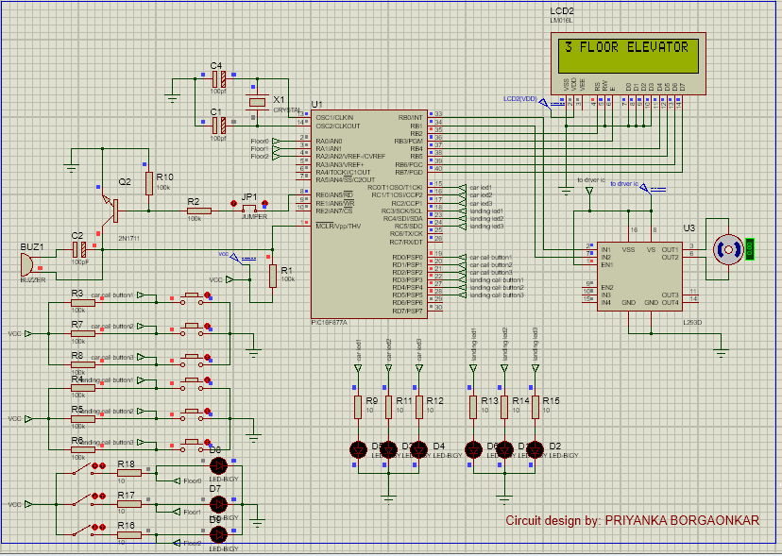
PROTEUS PROFESSIONAL
SUITE(Circuit Simulation)

Slide 16

COMPILER
Introduction to mikroC PRO for PIC
Help version: 2016/03/21
The mikroC PRO for PIC is a powerful, feature-rich development tool for PIC microcontrollers. It is designed to provide the programmer with the easiest possible solution to developing applications for embedded systems, without compromising performance or control.

Slide 17
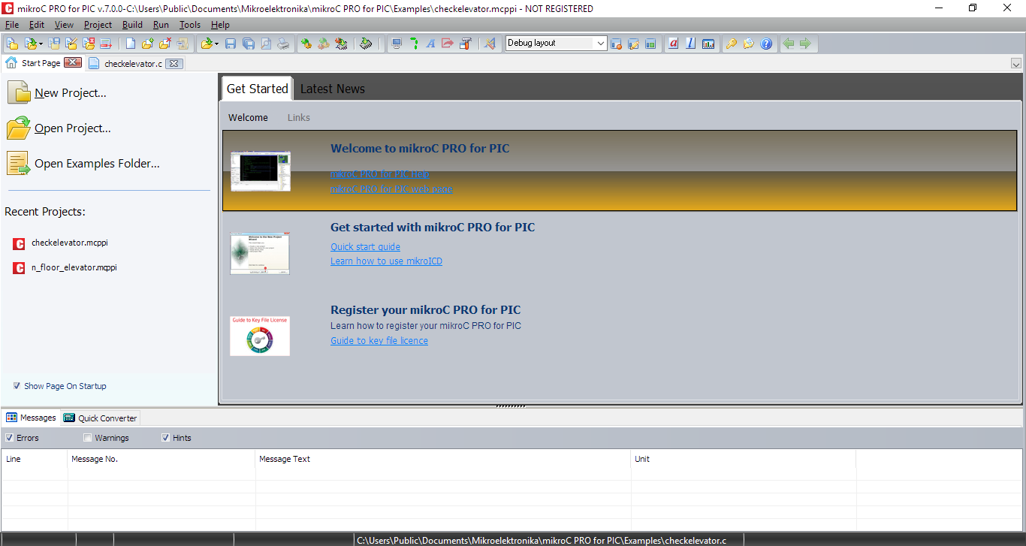
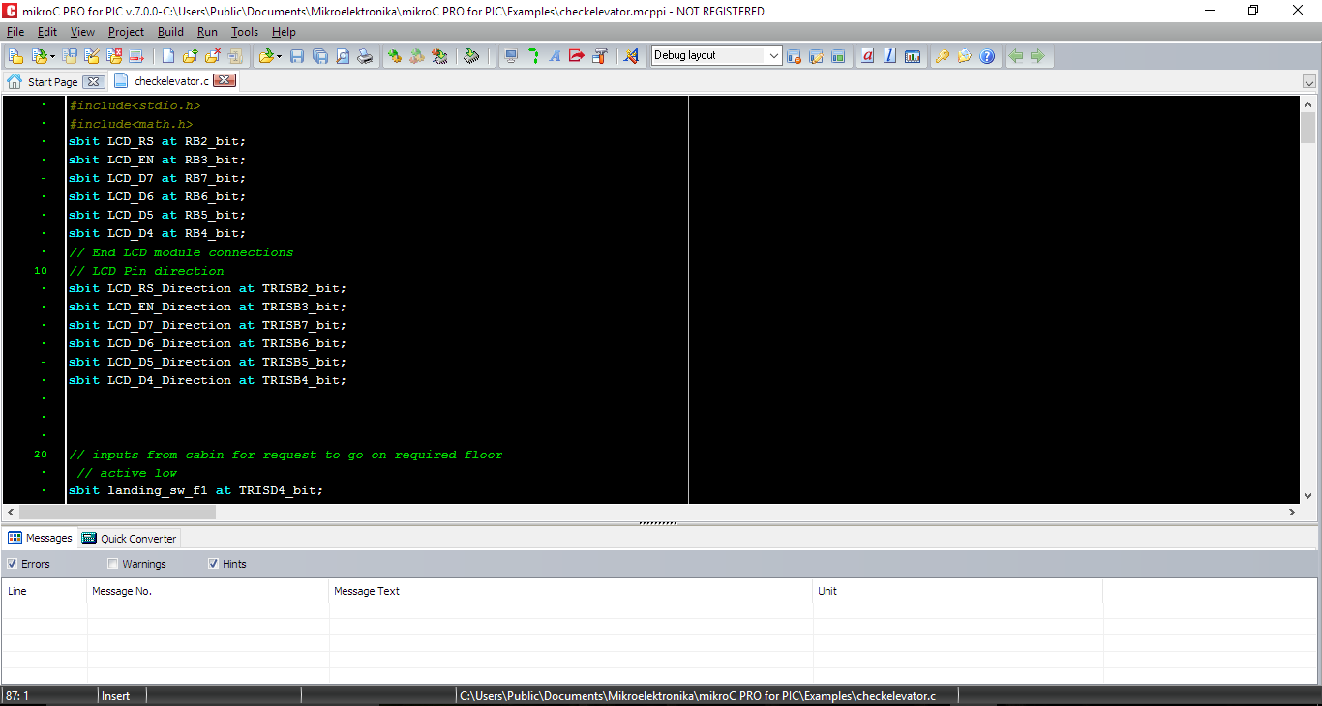
A MicroC PRO window

Slide 18
FUTURE SCOPE
In many high story buildigs such as housing societies, hospitals, malls there is an increasing demand for installation of elevators.
The companies making the elevator components ad CPU cards are also growing as the demand is increasing.
Moreover the the PIC microcontroller is a modern technology which is trending today in various electronic devices such as mobile phones, laptops,many day to day life devices such as air conditioners, Refridgerators, toys and for industrial control devices.

Slide 19
REFERENCES
PIC16F877A - Datasheet.
Let-us-c - Yashwant Kanetkar.
ebook: PIC Programming in C - Verle Milan.
website - http://www.mikroe.com/

Slide 20
THANK YOU!

